Slide 1
Post Office Portal – Phase 5
Enhanced document targeting and scheduling | Enable enhanced document targeting (region, service or WCC) Enable document publication scheduling. Document approval exemption (floorplans/planograms). Limit image 2MB and document size 2 GB.
POP Alerts enhancements | View all POP Alerts Preview POP Alerts Select messages to print

Slide 2
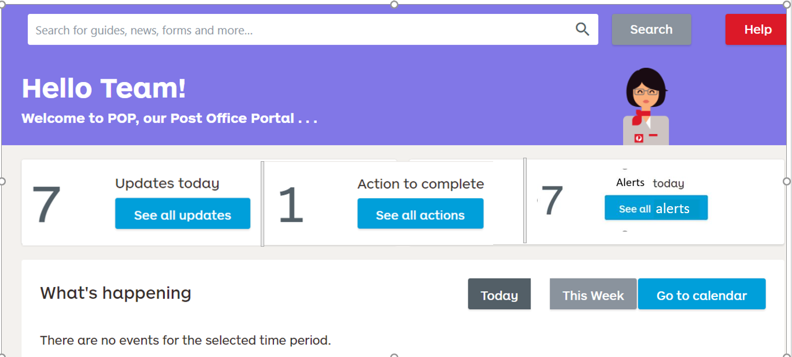
UI Design for Alerts display in Home page

Slide 3
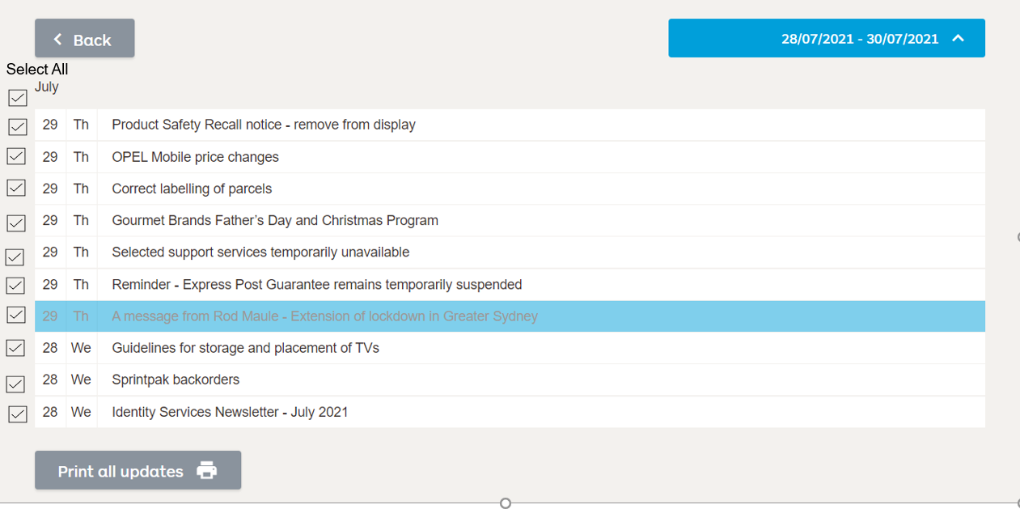
Print Updates –UI design
This is for the reference – use this as base for the design, also change the button text to – Print Selected Updates

